Slide 1


Slide 2
Dial-in details for Revit Presentation
TollFree Numbers:
AUSTRALIA 1-800-098-324
AUSTRIA 0800-677-287
BELGIUM 0800-4-9731
CHINA A 10800-712-1298
CHINA B 10800-120-1298
DENMARK 8088-5429
FINLAND 0800-1-15768
FRANCE 805-100-984
GERMANY 0800-101-7056
GREECE 00800-12-6810
HONG KONG 800-908-205
HUNGARY 06-800-17566
INDONESIA 001-803-011-3650
IRELAND 1800-932-054
ISRAEL 1-80-9214709
ITALY 0800-906-465
JAPAN 0034-800-400652
MALAYSIA 1-800-81-2059
NETHERLANDS 0800-343-4363
NEW ZEALAND 0800-441-452
NORWAY 800-10129
POLAND 00-800-1211769
PORTUGAL 8008-15135
SINGAPORE 800-120-4246
SOUTH AFRICA 080-09-92282
SOUTH KOREA 00798-14800-6608
SPAIN 800-099-728
SWEDEN 0200-893-410
SWITZERLAND 0800-001-215
TAIWAN 00801-137-662
THAILAND 001-800-1206-65425
UNITED KINGDOM 0800-279-9632
USA 866-617-3597
Toll Numbers:
AUSTRALIA 61-2-8211-1393
AUSTRIA 43-1-92-86-509
BELGIUM 32-2-400-1326
FINLAND 358-106-33-199
FRANCE 33-1-70-70-84-56
GERMANY 49-69-2222-3468
GREECE 30-80-1-100-0672
HONG KONG 852-2286-5639
IRELAND 353-1-247-5394
ITALY 39-02-3604-7040
JAPAN 81-3-5539-5161
LUXEMBOURG 352-27-000-1348
NETHERLANDS 31-20-717-6858
NEW ZEALAND 64-9-970-4657
NORWAY 47-21-59-00-48
SINGAPORE 65-6883-9205
SOUTH KOREA 82-2-6744-1059
SPAIN 34-91-414-0092
SWEDEN 46-8-505-98-267
SWITZERLAND 41-44-580-3897
TAIWAN 886-2-2795-7355
UNITED KINGDOM 44-20-7108-6391
USA 1-210-795-0625
Participant Code:
9672646

Slide 3


The New Revit 9 API
Fenton Webb
DevTech
Autodesk
UK

Slide 4
Agenda
  Overview of the New Product Features List
  Overview New API Features List
  New Samples Walk Through
  Migration Issues
  Programming Tips and Tricks we recommend.
Notes:
Today's Agenda will consist of:
An Overview of the New Product Features Listing – so we’ll take a quick look at the new features that the Revit Building 9 and Revit Structure 3 provide from the Product point of view,
Then we’ll take a look at an Overview of the New API Features Listing – starting with a look at the most significant changes we have made to the Revit9 API, then taking a look at the new objects that have been created, and some that have been removed. Also, we’ll take a look at some of the new creation methods that have been exposed for each of the Objects that now allow themselves to be programmatically created.
Next, we’ll take a look at the new samples in the New Samples Walk Through section of the presentation. Here, I’ll just give you an idea of what is possible with some of the new samples and try and give you real world examples of how they are used so you can get a better idea of how to make use of them in your own product.
After that, I wanted to talk to you about Migration issues that we have run into on the way, along with any tips on how to fix them in the Migration Issues section.
And finally, last but not least, I’ve gathered together a list of Programming Tips and Tricks from the rest of the DevTech team so we can try and point you in the right direction whist programming your all singing and dancing, really cool Revit applications!!

Slide 5
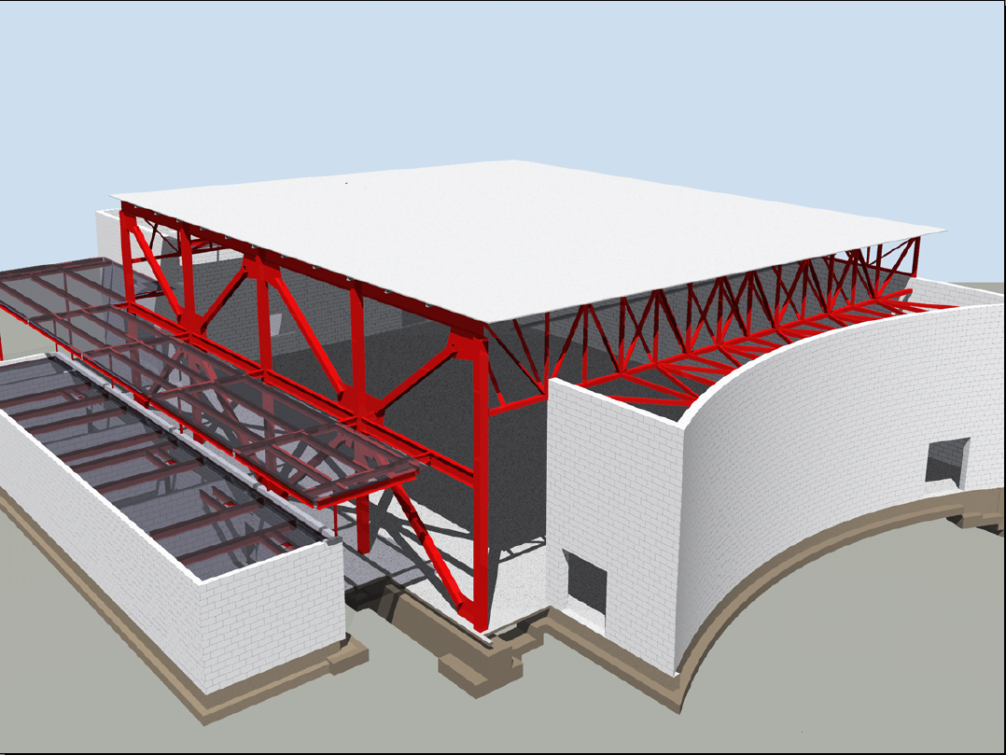
Revit Building 9 Top New Features List
Overview of Top Building 9 New Features…
  Works the Way you Think
    Volumetric Room Calculations
    Additional Room Bounding Elements
    Sun Studies
    User Defined Selection Filters
  Better Coordination & Quality
    Detail Library
    Keynoting
    Reuse Drafting Views, Schedules, & Sheets
    Material Take Offs
    Query Elements in Linked Files
    View Annotations in Linked Files
    Coordination Monitor –Walls & Slabs
  Better for Your Business
    Properties in 2D DWF
    DWG Import/Export Improvements
    IFC Import
Notes:
So, this slide shows a brief overview of the top Revit Building 9 new features.
We start with the “Works the Way you think” section – so, we learned that Volumetric Room Calculations did not work the way most of our users wanted it to and until Revit 9 we didn’t have a dedicated Room Object, so as we all know, to create a Room you had to place a Room tag in an enclosed area, and of course, another problem was that a Room could not exist without that room tag, which was a pain. So now we have a fully defined Room object with all the possible properties added to it, and that means that it’s now fully independent from the Room Tag! Also, because of the fact that rooms didn’t exist as actual rooms, there was NO volume calculation whatsoever, but now Revit calculates the volume for us! This is for both straight as well as free form shaped rooms.
Next we have Additional Room Bounding Elements – so to quickly explain this new feature, up until this version Columns, In-place families, Curtain systems, Roofs and Ceilings were NOT Room Bounding. This meant that were ignored by the room calculation. Now they all have an additional parameter ROOM bounding which can be examined by the room object, so that’s it.
I think the Sun Studies really explains itself there.
Regarding the User defined Selection Filters, up to R9 there was no correct way to turn off or graphically override a part of one category. You could either turn them ALL off or none at all, or override them all from one type but not just few, this was a real pain to a lot of users. Now though, all of this is possible with the filters, so enjoy!
Next we have a a new detail Library, with over 500 new components sorted in a CSI catalogue to choose from, just like ADT – so that’s a great improvement.
The keynotes can now be setup to rely on information stored elsewhere. An extra point to note is that all Revit objects now have a KEYNOTE parameter which can be setup to pull notes from a text file, so that’s quite a nice feature to mention also.
Regarding the reuse of Drafting views, Scheduling and Sheets section of the slide there - until R9 there was no way to reuse a drafting view from one project into another. So the way a user got round this was to export it to AutoCAD and then re-import it in a drafting view as a DWG in the other project. Now, you can simply SAVE and re-import drafting views in any other project. You can also save and reuse SHEETS with the entire layout which is really cool. Another good point to mention is that if the sheet had a schedule table on it, it will recreate the schedule in the new project using the data from the current database. The last point is, Schedules in 9 can be saved as view templates – how is this used I hear you ask? if you have 20 schedules and change the look of one (with different line thicknesses, text styles etc) and wanted all other 19 to look like that one – you just save the one as a view template and apply it to the other schedules to have the same look and feel, that’s really powerful stuff for the user.
Next we have Material Take off – this is a new type of view that allows, for the first time, to calculate take offs of materials in a project. For instance, say we have a wall with 7 layers, it will report the area, volume, surface etc of each of the individual layers, very cool. You can also do a multi-category material take off and get the entire concrete in the building regardless if its in walls, roofs, slabs etc.
For the Coordination Monitor – Basically, until now structure and building only monitored each others grids, levels and walls. Now in this latest version it also includes walls and slabs.
We now have more properties exposed in the DWF exports.
The DWG Import/Export improvements include:
Export options : by layer
Export options: coordinates
Layers settings are preserved when the linked file is reloaded
It now Allows Match Line Type scale of export from Revit to dwg to standard LTSCALE and PSLTCALE (paper space or model space) line scaling
Any Hidden lines automatically generated are now exported to user definable layers
Fill patterns (hatches) exported to separate layers
Exports Grid Level lines and Grid Level heads on separate layers
IFC is the file format that reads properties from objects coming from different object technologies (ADT can read Revit properties and also Archicad, Triform etc) up until now Revit had IFC EXPORT, but now we have included an IFC IMPORT also which means that it can read ADT or Archicad file with all object properties (excluding ACIS solids)
This is a new feature list, most of which is not yet exposed via the API.

Slide 6
Revit Structure 3 Top New Features List
Overview of the Structure 3 Top new features…
  Modelling and Analysis
    Member support and analytical consistency checks
    Links to more analysis software
    Modeling Enhancements for sloped elements
    New Filter Selection
  Construction Documentation
    Details Management
    Improved Annotations, Keynoting
    Detail components
    New Detailing tools for Reinforced Concrete
    Improved Graphical Column Schedule
  Multidiscipline Interoperability
    Enhanced Coordination Monitor with Revit Building 9
    Worksharing and Linked files Enhancements
    Interoperability with Revit Systems
    IFC Import
    DWF Toolkit
Notes:
So for the Modelling and Analysis heading there, the biggest thing is that creating sloped elements now takes 2 steps where before it took over 20! So that’s a great improvement.
Moving on quickly now, most of the new features are directly related to the Revit Building 9 features list, but for Structural.

Slide 7

New API Features

Slide 8

Revit 9 API New Features List
Significant API features
  Element Creation
    Extended list of Creatable Elements
      Walls, Floors, Levels, Grids and all Family Based Elements
  Track Changes
    This feature lets the user visually see the changes performed by the 3rd party application. It also lets the user accept or reject the changes. Check out the Revit Structure3 features.doc in the RST folder of the SDK.
Notes:
So in terms new API features displayed there on your screen, it looks like there’s not a lot to see really, but as we all know the newly added to Element creation list is a massive inclusion. We can now create Walls, Floors, Levels, Grids and all Family Based Elements which means that the Revit API is now becoming a very powerful API indeed.
We also have the new Track Changes feature, which at the moment is only available in Revit structure. What it does is to track certain changes to elements across a single API external command, allowing the user to revert the changes back to what they were before a user ran your command. The way you revert a change is by Right-clicking the element you want to revert, and you should see the reversion options displayed there.

Slide 9
Revit 9 API New Features List
  Geometry
    BoundingBoxXYZ
    ConicalFace
    CylindricalFace
    DoubleArray/Iterator
    HermiteFace
    PlanarFace
    Reference
    ReferenceArray/Iterator
    RevolvedFace
    RuledFace
  Structural
    AnalyticalSupportData
    AnalyticalSupportInfo
    AnalyticalSupportInfoArray/Iterator
    BarDescription
Changes in the API
New Objects
  Elements
    AreaReinforcement
    AreaReinforcementCurve
    Dimension
    LoadCaseArray/Iterator
    LoadUsage
    LoadUsageArray/Iterator
    View
    View3D
    ViewDrafting
    ViewSection
    ViewSet/Iterator
    ViewSheet
  Symbols
    AreaReinforcementType
    DimensionType
  Objects
    ExternalCommandData

Slide 10
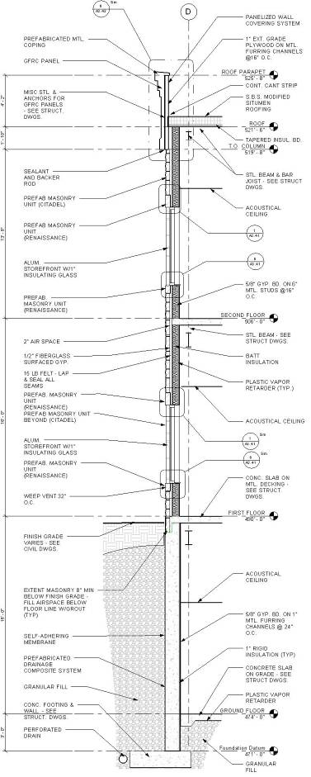
Revit 9 API New Features List
Changes in the API
Moved Objects
  RebarBarType
    Moved from the Elements namespace to the Symbols namespace
  RebarHookType
    Moved from the Elements namespace to the Symbols namespace
Deleted Objects
  None for this release

Slide 11
Revit 9 API New Features List
Changes in the API
New Creation Methods
  AreaReinforcement
  Dimension
  Structural FamilyInstances
  Floor
  Grid
  Level
  LoadCase
  LoadCombination
  LoadNature (Used to define the type of load as Dead, Live, Seismic, Wind etc.)
  LoadUsage (Used for visibility of loads only)
  View3D
  ViewDrafting
  ViewSection
  ViewSheet
  Wall

Slide 12

Revit API New Samples

Slide 13
Revit 9 API Samples Listing
New Sample Name Works with Building/Structure?
AllViews Both x
AnalyticalSupportData_Info Structure Only
AreaReinCurve Structure Only
AreaReinParameters Structure Only
BarDescriptions Structure Only
BeamAndSlabNewParameter Structure Only
CreateBeamsColumnsBraces Both x
CreateSimpleAreaRein Structure Only x
CreateComplexAreaRein Structure Only x
CreateDimensions Both x
DeleteDimensions Both x
CreateViewSection Both x
CreateWallinBeamProfile Structure Only*
CreateWallsUnderBeams Both x
DeleteObject Both
DesignOptionReader Both
GenerateFloor Both x
InPlaceMembers Both
LevelsProperty Both
Loads Structure Only
MaterialProperties Both
ObjectViewer Both
PhaseSample Both
RotateFramingObjects Both x
SlabProperties Structure Only
StructuralLayerFunction Structure Only
VersionChecking Both x
Notes:
Fenton’s notes: * The main demoed functionality (to create walls) would work in both, but it relies on analytical model of beams for the position, which fails in Building...

Slide 14
Revit 9 Samples Listing
Sample Name (now in .NET) Works with Building/Structure?
CreateShared Both
TypeSelector Both
AnalyticalViewer Structure Only x
BrowseBindings Both
LibraryPaths (now in RevitCommands) Both
LoadFamily (now in RevitCommands) Both
MoveLinear Both
PhysicalProp Structure Only
RotateElement Both
RevitViewer Both
ElementViewer Both x
RoomViewer Both

Slide 15
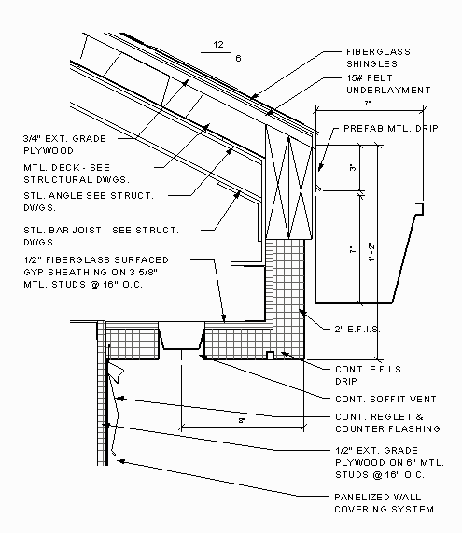
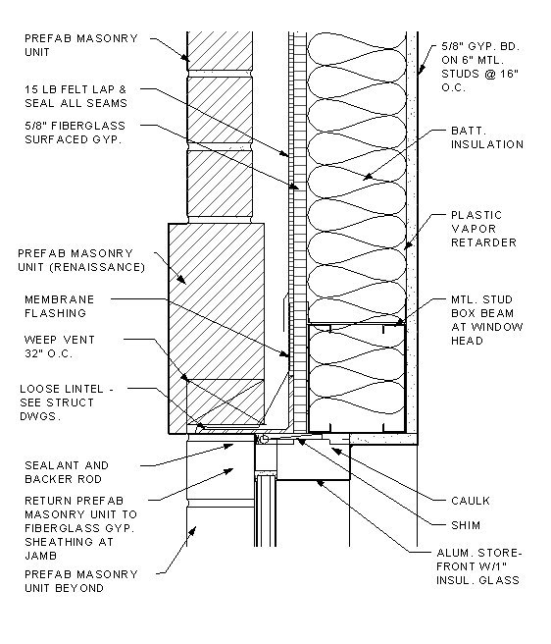
Revit Building 9/Structure3 Samples Walkthrough
AllViews – works with Both
  Finds all Views in Project and displays in Treeview
  Creates a new sheet with Views that were selected.
    Demonstrates creating a ViewSheet via NewViewSheet()
Notes:
This sample finds all the views in a project and displays the names in a TreeView hosted by the Modal Dialog that is displayed. The user can select several of the views and when OK is clicked a new sheet is generated that has all the selected views placed in it correctly sized, scaled and aligned.
When the command is executed a dialog should appear that contains the following:
a) A tree view represents all the views’ names.
b) A list of all title blocks.
c) An edit box for the sheet’s name.
Note: All views should represent by category, not including schedules, sheets.
Fenton’s notes:
Loading this drawing Training\Metric\m_RST_SAVE DETAIL.rvt? allows me to produce new sheets of all the elevations.
Extra Usage Notes:
draw a simple model.
(2) check the current status of views and sheet. If there is no sheet, fine.
(3) run the command.
choose views. Click ok.
check under Sheets. You should see a sheet where the selected views are placed.

Slide 16

Revit Building 9/Structure3 Samples Walkthrough
CreateBeamsColumnsBraces – Both
  Demonstrates the Creation of new objects.
    Using NewFamilyInstance() to create Structural Elements.
STRUCTURALTYPE structuralType = StructuralType.Beam;
FamilyInstance beam;
// create the beam
beam = m_revit.ActiveDocument.Create.NewFamilyInstance
(ref startPoint, beamType, topLevel, structuralType);
// assign the location curve to the beam
LocationCurve beamCurve = beam.Location as LocationCurve;
if (null != beamCurve)
{
Line line;
line = m_revit.Create.NewLineBound(ref startPoint, ref endPoint);
beamCurve.Curve = line;
}
Notes:
This sample demonstrates the creation of new objects, in particular the NewFamilyInstance(). Notice that there’s some code below which shows how it’s done.
So lets take a look at the sample to see what it does exactly.
Fenton’s notes: Create a new project. Pick elevations to create 5 new levels, run the program.

Slide 17
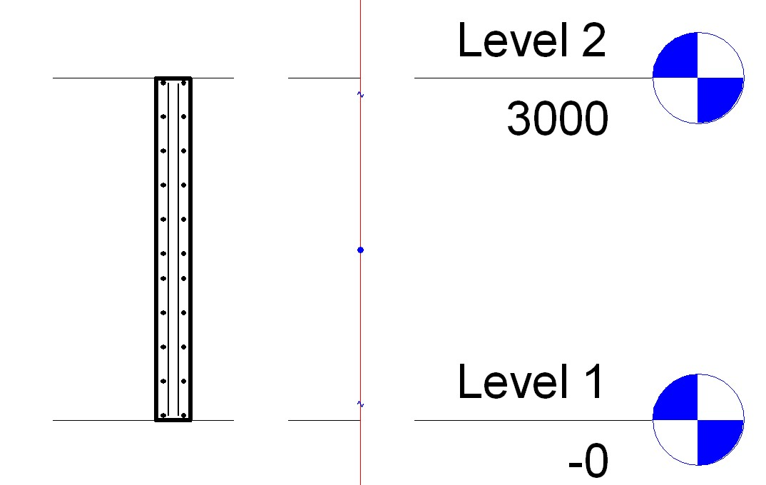
Revit Building 9/Structure3 Samples Walkthrough
CreateSimpleAreaRein – Structure Only
  Demonstrates the Creation of AreaReinforcement Element.
    Using NewAreaReinforcement().
    Works on Slab or Wall.
AreaReinforcementType symbol;
symbol = dataOnWall.AreaReinType as AreaReinforcementType;
DocCreator creator = m_revit.Application.ActiveDocument.Create;
// create the Area Reinforcement
AreaReinforcement areaRein;
areaRein = creator.NewAreaReinforcement(symbol, wall, refer, curves);
Notes:
This sample creates an Area Reinforcement in a rectangular shape on a slab or wall. So lets take a look.
Fenton’s Notes:
Goto 3d view, then draw a wall/floor.
select it, and execute the command. Accept default and ok. It will add a rebars to the wall/floor. (But it may not be visible.)
try moving the cursor to the centre of the wall. You will see a "x" mark with "structural area reinforcement". This is what is added.
Goto Level1, then try creating a section. (View --> New --> Section). if you zoom in the section of a wall, you will see rebars placed inside of the wall.

Slide 18
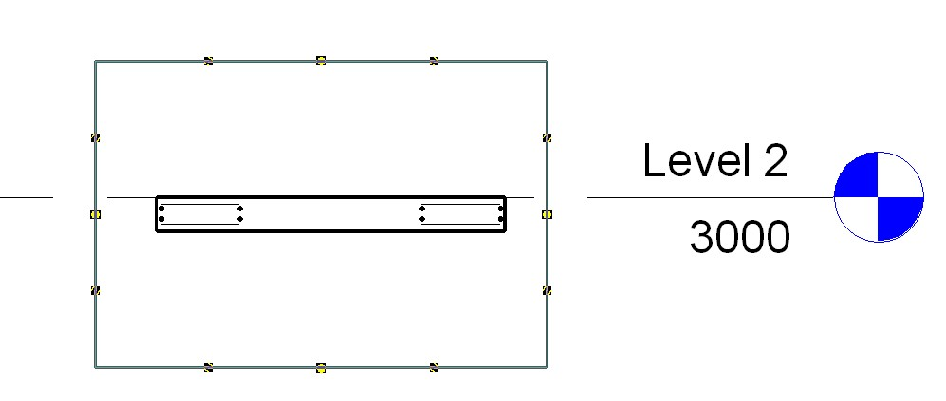
Revit Building 9/Structure3 Samples Walkthrough
CreateComplexAreaRein – Structure Only
  Demonstrates the Creation of AreaReinforcement Element.
    Using NewAreaReinforcement().
    Defines opening/cutout in Slab.
    Only works on Slab.
Notes:
This sample is very similar CreateSimpleAreaRein, except that it generates a much more complex reinforcement detail and only works for a Slab or floor.
The detail is created with all four layers of reinforcement defined and with two nested rectangular curve loops so that it defines a rectangular cutout opening, really cool stuff – so lets take a look.
On the interior 4 curves, set the override flag and flip the hooks on the top 2 layers to ¡°up,¡± so the bars can hook into some walls around that opening.?

Slide 19
Revit Building 9/Structure3 Samples Walkthrough
CreateDimensions – Both
DeleteDimensions – Both
  Demonstrates the Creation of a Dimension.
    Using NewDimension().
// create dimension line geometry
Line newLine2 = new Line(ref point1, ref point2, true);
// now create the actual dimension
Dimension newDimension;
newDimension =
m_revit.Application.ActiveDocument.Create.NewDimension (m_revit.Application.ActiveDocument.ActiveView,
newLine2, referenceArray);
Notes:
This sample requires a Basic wall to be drawn and selected in order to function.
NOTE: If you are going to use this same inside Structural be aware that, by default, Basic Walls are NOT displayed unless you turn them on. Goto View properties -> Discipline, here it will be set to either Structural or Analytical (this excludes anything not having that model type property) – simply change it to "Architectural" .

Slide 20
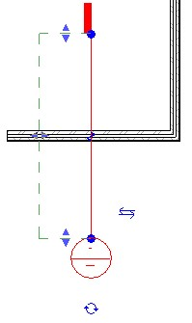
Revit Building 9/Structure3 Samples Walkthrough
CreateViewSection – Both
  Demonstrates the creation of a Detail View.
    Using NewViewSection().
    Creates detail view across the mid point of selected element.
    Works on Linear elements such as Slab, Wall or Beam.
// Create a section view.
ViewSection section = m_project.Create.NewViewSection(m_box);
Notes:
Next we have the CreateViewSection sample; this sample provides a tool for generating a section view across the mid point of a selected element.
Fenton’s notes: Draw a wall, beam or floor then select it to run the application.

Slide 21
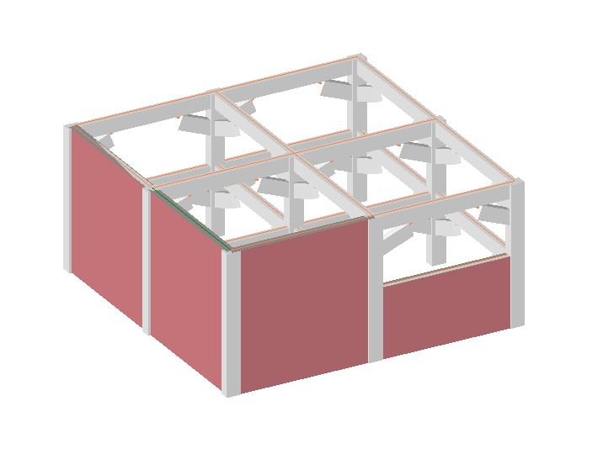
Revit Building 9/Structure3 Samples Walkthrough
CreateWallsUnderBeams – Both
  Demonstrates the creation of Walls under selected Beams.
    Using NewWall().
    Illustrates the AnalyticalModelFrame class
      (How to Convert from Physical Model)
Notes:
Fenton’s Notes: Create Beams Columns and Braces in Structure 3. Select one or more of the beams and run the CreateWallsUnderBeams sample. This will create the walls, to show them, switch the shade mode to shaded.

Slide 22
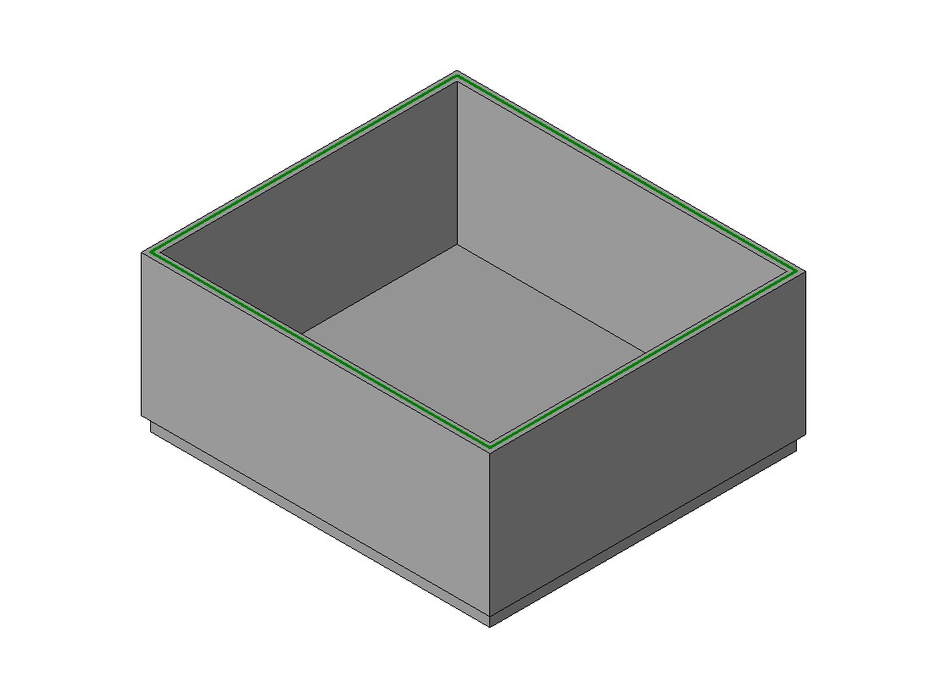
Revit Building 9/Structure3 Samples Walkthrough
GenerateFloor – Both
  Demonstrates the creation of a Slab/Floor.
    Using NewFloor().
// Create a new Floor.
Floor f;
F = doc.Create.NewFloor(data.Profile, data.FloorType, data.Level, data.Structural);
Notes:
This sample is very straight forward, you draw a closed room and run the command. You may get the Floor drawn on Level2 so set the properties of each of the walls so that the top constraint is level1 with a base offset of 0.0.
Fenton’s notes: Draw a wall, beam or floor then select it to run the application.

Slide 23
Revit Building 9/Structure3 Samples Walkthrough
RotateFramingObjects – Both
  Demonstrates how to Rotate Elements.
    Using Parameter Access.
Parameter familyAttribute = o as Parameter;
if (familyAttribute.Definition.Name == parameterName)
{
Autodesk.Revit.Parameters.StorageType st = familyAttribute.StorageType;
switch (st)
{
case (Autodesk.Revit.Parameters.StorageType.Double):
{
if (parameterName == "Angle")
{
//make conversion between degrees and radians
Double temp = familyAttribute.AsDouble();
valueOfParameter = Math.Round(temp * 180 / (Math.PI), 3).ToString();
}
Notes:
This next sample is a minimal sample which simply shows how to rotate objects selected from a Revit model via the API.
Fenton’s notes: Use Create Beams Columns and Braces to generate some test geometry, now you can run RotateFramingObjects nicely.

Slide 24
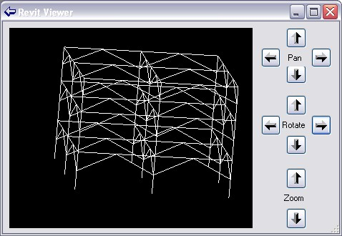
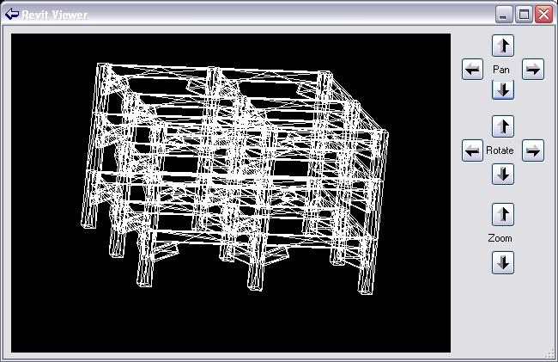
Revit Building 9/Structure3 Samples Walkthrough
AnalyticalViewer Structure Only
ElementViewer Both
  Demonstrates Viewing Elements.
    For Analytical Model see AnayticalViewer
    For Physical Model see ElementViewer

Slide 25
Revit Building 9/Structure3 Samples Walkthrough
VersionChecking Both
  Demonstrates how to Access the Running Product version
    The most requested API feature!
    Allows developers to channel functionality.
    Data is built into the Application class
      VersionName
      VersionNumber
      VersionBuild

Slide 26
Revit Building 9/Structure3 Samples Walkthrough
  Modifying the revit.ini file
  Or Download the Samples Revit.ini from ADN
[ExternalCommands]
ECCount=<n>
ECName<i>="HelloRevit - DevDay"
ECDescription<i>="Shows a message box with Hello Revit!"
ECClassName<i>=HelloRevit.HelloRevit_Cmd
ECAssembly<i>="C:\Temp\DevDay Tokyo\HelloRevit\bin\HelloRevit.dll"
...
Notes:
To get these samples working inside of Revit building 9 or Structure 3, you must modify the revit.ini file as shown above to include a path, command name, etc to your assembly.

Slide 27
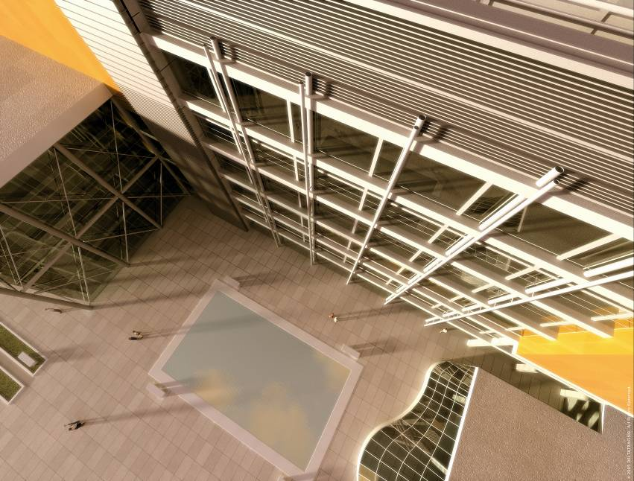
Revit 9/Structure 3 Migration Issues
Entry Point Signature
  The entry point Execute() has changed from
  to
Execute(Application application, ref String message, ElementSet elements)
Execute (ExternalCommandData commandData, ref string message, ElementSet elements)

Slide 28
Revit 9/Structure 3 Migration Issues
Parameters
  Various Name changes
    E.g. Parameter.Type is now Parameter.ParamType
  Tidying
    E.g. Geometry object has been updated
  Removed
    PHY_MATERIAL_PARAM_BENDING_REINFORCEMENT
    PHY_MATERIAL_PARAM_SHEAR_REINFORCEMENT
    PHY_MATERIAL_PARAM_RESISTANCE_CALC_STRENGTH

Slide 29
Revit 9/Structure 3 Migration Issues
New Compiler
  Revit 9 is built with Visual Studio 2005
    Using 2.0 .NET runtime.
    A more strict compiler.
    Watch out for problems debugging in previous versions of VS
      You need to specify the .NET runtime in the revit.exe.config
      Create a revit.exe.config if it doesn’t exist.
      <?xml version="1.0"?>
      <configuration>
      <startup>
      <supportedRuntime version="v1.1.4322"/>
      </startup>
      </configuration>

Slide 30

Revit 9/Structure 3 Tips and Tricks
Debugging Tools
  Use Revit DBG to snoop database (see ADN Site)
    Great for seeing where Parameters are stored.
  Element Viewer to work out Geometry.
Save time
  Download the Samples Revit.ini (see ADN Site)
  Download the AllSamples.sln (see ADN Site)
Localisation
  Some Parameter names are localised.
  Use BuiltInCategory namespace where possible.
// works only in English
if (Category.Name == “Windows”)
is now better coded
// works in any language
if (Category.Name == BuiltInCategory.OSTWindows)

Slide 31
Revit 9/Structure 3 Tips and Tricks
Structure Test Models
  Use these to test you applications
  Precursor to the Certification Program
  Find them on the ADN Website

Slide 32
Revit 9/Structure 3 Tips and Tricks
Understand Revit first!
Don’t just port existing applications and practices to Revit
Understand customer needs first – not just what customers ask for

Slide 33
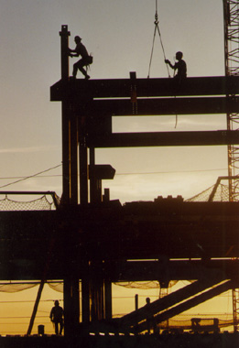
Revit API

